Slide 1
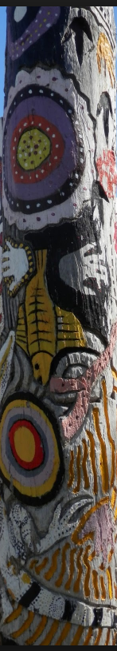

Activity –
Create your Totem

Slide 2
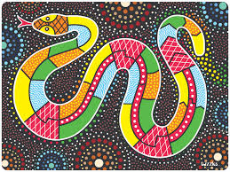

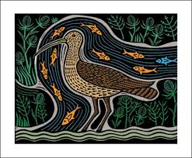
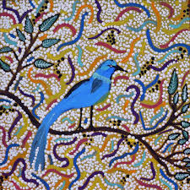
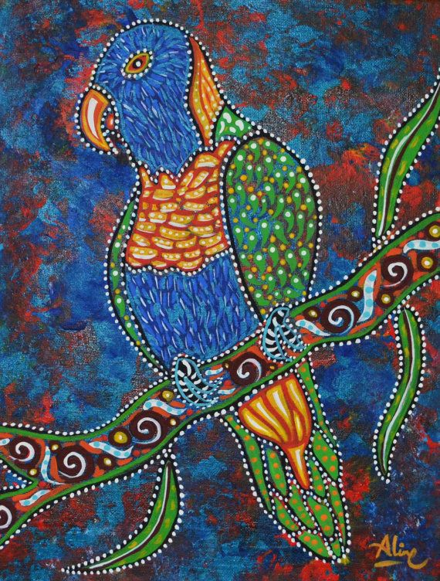
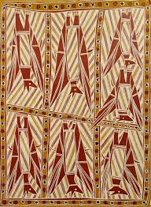




Activity – Create your Totem Pole
Choose your totem
Your Totem
Rainbow serpent
Crocodile
Curlew
Willy Wagtail
Parrot
Flying Fox
Crow
Eaglehawk
Koala
Taipan snake
Drag your preferred totem to the right to create your totem pole

Slide 3
(EXAMPLE)
Activity – Create your Totem Pole
Choose your totem
Your Totem
Rainbow serpent
Crocodile
Curlew
Willy Wagtail
Parrot
Flying Fox
Crow
Eaglehawk
Koala
Taipan snake
Drag your preferred totem to the right to create your totem pole

